Slide 1
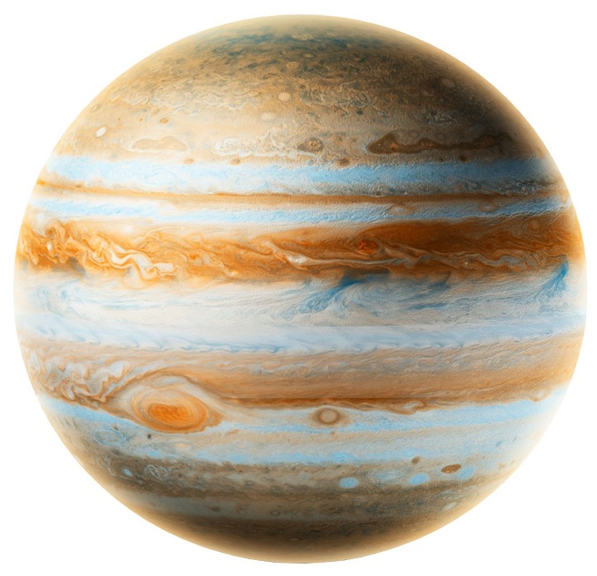
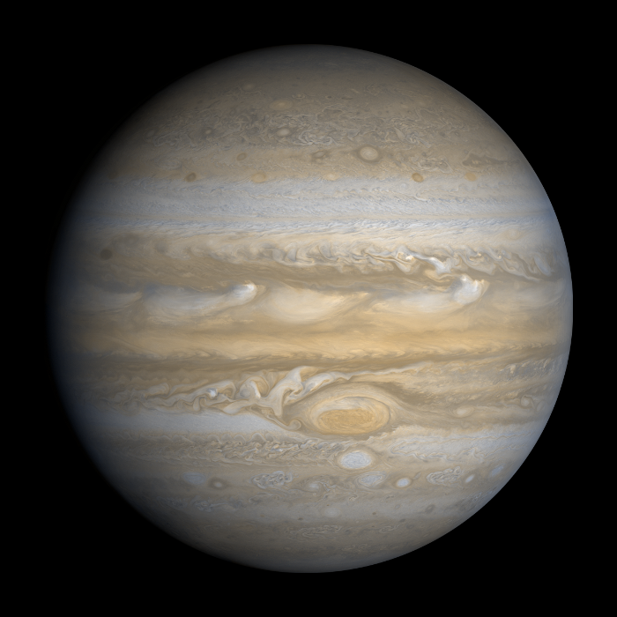
Facts about Jupiter

Slide 2
Jupiter facts
The planet Jupiter is fifth planet out from the sun, and is two and a half times more massive than all the planets in the solar system combined. It is made primarily of gases and is therefore known as a “gas giant”.
Jupiter is the fourth brightest object in the solar system .Jupitar
orbits the sun every 11.8 Earth years. Jupitar has a thin ring system.
Jupiter’s interior is made of rock, metal, and hydrogen compounds.
Below Jupiter’s massive atmosphere (which is made primarily of hydrogen), there are layers of compressed hydrogen gas, liquid metallic hydrogen, and a core of ice, rock, and metals.

Slide 3
Jupiter fact
Jupiter is like a star in composition. If Jupiter had been about 80 times more massive, it would have become a star rather than a planet.
The upper atmosphere of Jupiter is divided into cloud belts and zones. They are made primarily of ammonia crystals, sulphur and mixtures of the two compounds.
Its rings are composed mainly of dust particles ejected from some of Jupiter’s smaller worlds during impacts from incoming comets and asteroids.
One of Jupiter's most famous features is the Great Red Spot. It is a giant spinning storm, resembling a hurricane. At its widest point, the storm is about 3 1/2 times the diameter of Earth. Jupiter is very windy.

Slide 4
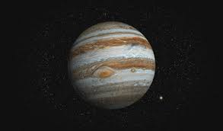
Jupitar fact
Jupiter has three thin rings that are difficult to see. NASA’s Voyager 1 spacecraft discovered the rings in 1979. Jupiter’s rings are made up mostly of tiny dust particles.
Jupiter is the fastest spinning planet in Solar System. It completes one rotation around its axis in just under 10 hours.
Jupiter’s atmosphere is very similar to that of our Sun. The atmosphere is made up to mostly helium and hydrogen

Slide 5
Jupiter fact
Jupiter is 778.5 million km from the sun.
A day on Jupiter is 0d 9h 56m.
One year on Jupiter is 12 years on earth.
Jupiter was discovered in 1610 by Galileo Galilei
Jupiter gravity is 24,79
Jupiter diameter is 139,822 km
Jupiter size is 69,911km

